Slide 1

Immigration, Crime, and GDP Analysis by Mirko Yonathan Ciotta
This presentation explores the relationship between immigration, crime, and GDP growth in Italy, Germany, and France.

Slide 2

Methodology and Data Preparation
Data from Eurostat and other official sources was used. Crime, immigration, and GDP data were normalized and prepared for analysis.
Key Variables:
- Crime Growth: Year-over-year percentage change in crime counts.
- Immigration Growth: Year-over-year percentage change in immigrant counts.
- GDP Growth: Annual GDP growth rate for each country.

Slide 3
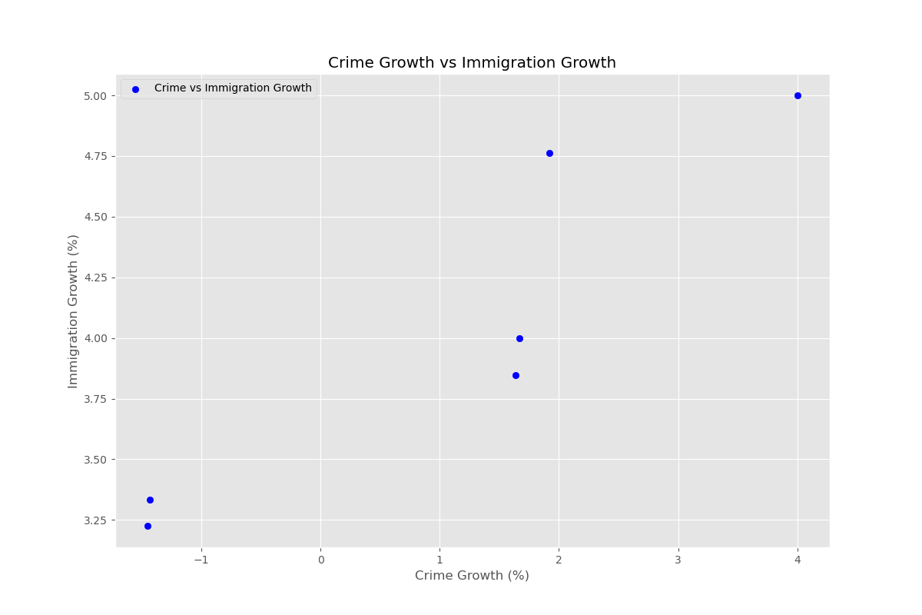
Visualization 1 - Crime Growth vs. Immigration Growth
This visualization shows the relationship between crime growth and immigration growth. We can observe that the trends do not always correlate directly, indicating that immigration growth does not necessarily lead to a proportional increase in crime.

Slide 4
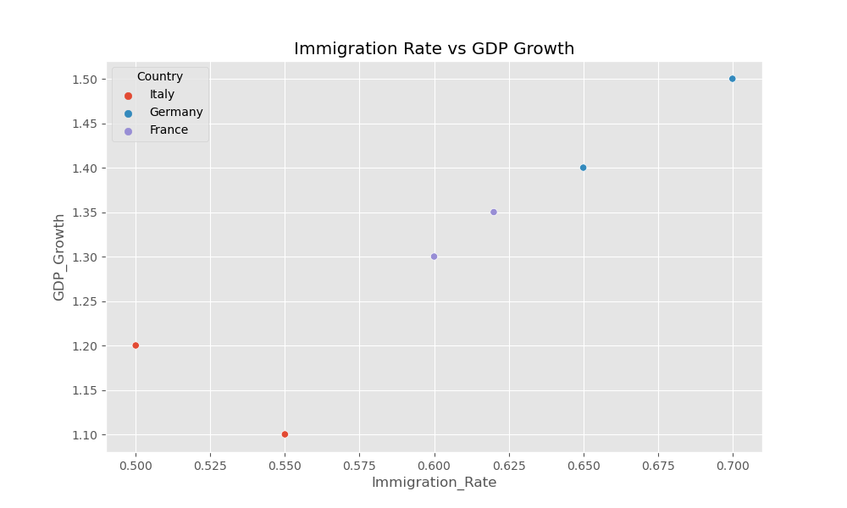
Visualization 2 - Immigration Rate vs. GDP Growth
This visualization highlights the relationship between the immigration rate and GDP growth. The analysis shows that there is no clear linear relationship between the immigration rate and GDP growth across the studied countries.

Slide 5
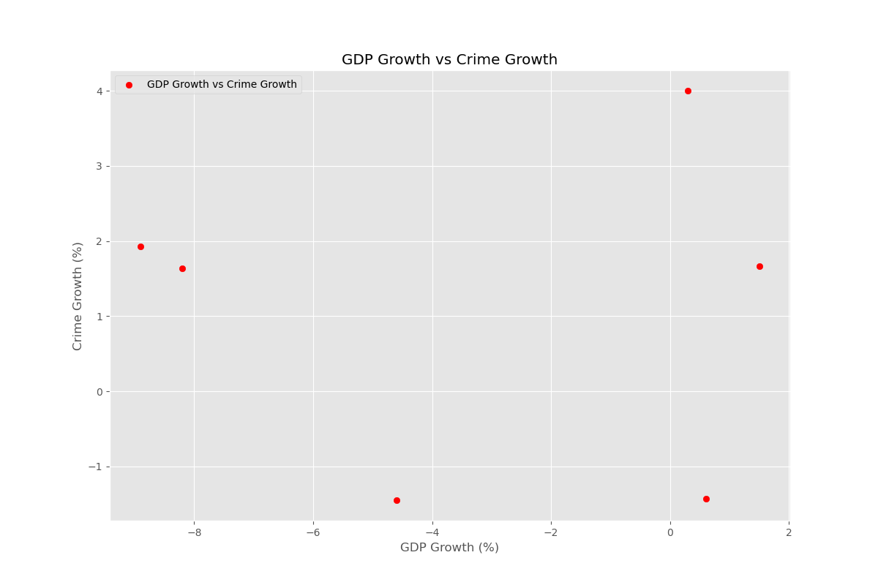
Visualization 3 - GDP Growth vs. Crime Growth
This visualization compares GDP growth with crime growth. We observe that economic growth does not always translate to reduced crime rates, suggesting the presence of other influencing factors.

Slide 6
Synthesis and Conclusions
1. Crime vs Immigration:
- The data suggests that there is no direct linear correlation between immigration growth and crime growth.
2. Immigration vs GDP:
- No consistent pattern observed between immigration growth and GDP growth.
3. GDP vs Crime:
- Economic growth does not directly translate into reduced crime rates, highlighting the complexity of socio-economic factors involved.

Slide 7
Policy Recommendations
Based on the findings, the following recommendations are proposed:
- Focus on social integration policies for immigrants to foster economic contributions.
- Invest in education and employment opportunities to mitigate crime regardless of economic growth trends.
- Further research is needed to understand the complex relationship between immigration, crime, and economic development.

Slide 8
Future Research
Future research could explore the following areas:
- Impact of specific immigrant demographics on economic and social factors.
- Longitudinal studies on the effect of second-generation immigrants.
- Comparative analysis with other countries beyond Europe.

Slide 9
Acknowledgments and References
Data Sources:
- Eurostat
- World Bank
Special thanks to all contributors and researchers involved in the project.

